Slide 1
A Bootstrap Test of Stochastic Equality of Two Populations
Reiczigel et al. (2005). American Statistical Association, 59(2), 156-161

Slide 2
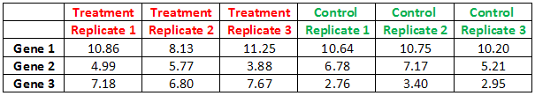
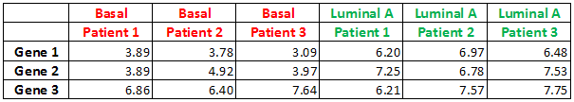
Statistical Hypothesis Tests
Making a definite decision with respect to an uncertain hypothesis which is known only through its observable consequences
Differential Expression in Microarray data analysis
H0: Mean(Treatment) = Mean (Control)
H1: The means differ
Study of Basal vs other subtypes of breast carcinomas*
H0: Mean(Basal) = Mean(Luminal A)
H1: The means differ
*Sorlie et al (2003). “Repeated observation of breast tumor subtypes in independent gene expression data set”,
PNAS USA, 100.

Slide 3
Approaches
Parametric tests
Non-parametric tests
Bootstrap tests

Slide 4
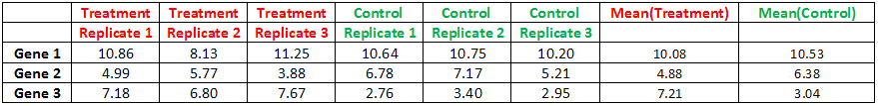
Parametric Tests
Parametric: Data follow the Normal distribution or can be transformed into Normally distributed data (at least approximately).
Examples: Log-transformation, square-root transformation etc.
Statistical tools: z-test or t-test for the means, ANOVA, Pearson correlation, OLS linear regression etc.
H0: Mean(Treatment) = Mean (Control)
H1: The means differ

Slide 5
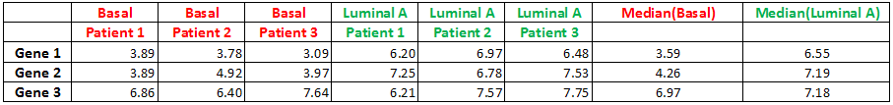
Non-parametric tests
Non-parametric: (i) Data (ranks or scores) are not Normally distributed and cannot be transformed into Normal, (ii) Some values are “off the scale”, that is, too high or too low to measure
Statistical tools: Wilcoxon/Mann-Whitney test, Kruskal-Wallis/Friedman test, Spearman correlation, Generalized linear regression etc.
H0: Median(Basal) = Median(Luminal A)
H1: The medians differ
OR
H0: P(Basal < Luminal A) = P(Basal > Luminal A)
H1: P(Basal < Luminal A) ≠ P(Basal > Luminal A)

Slide 6
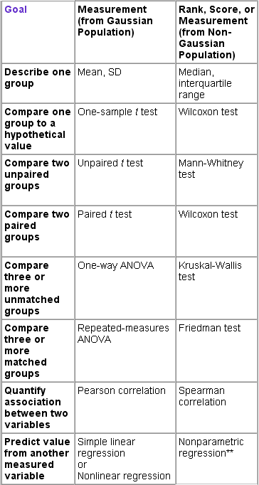
Parametric & Non-parametric alternatives
Parametric vs Non-parametric*
Data distribution
Type I error
Power of test
Sample size
Several statistical/mathematical packages perform these calculations
(e.g. R, SPSS, SAS etc)
* Horn et al., (2000). “Sample size determination for testing whether an identified treatment is best”, Biometrics, 56, 879-881
Zimmerman (1987). “Comparative Power of Student T Test and Mann-Whitney U Test for Unequal Sample Sizes and
Variances”, Journal of Experimental Education, 55, 171-176
Hart (2001). “Mann-Whitney test is not just a test of medians: differences in spread can be important”, BMJ, 323: 391-393

Slide 7
Two statistical problems
Within samples
Independent & identically distributed data
(not addressed in the paper)
Identically distributed populations under comparison
(the paper is focused on this)
Across samples

Slide 8
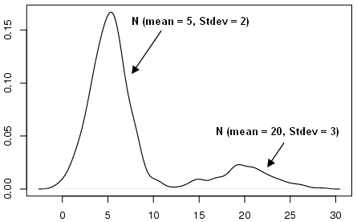
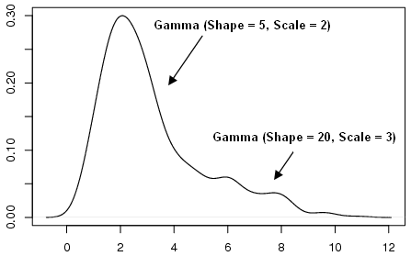
Common assumption of parametric & non-parametric tests (within samples)
Data are independently and identically distributed
Independent observations, identically distributed data, distributions are unimodal

Slide 9
Homogeneity assumption for parametric & non-parametric tests (across samples)
Homogeneity
The populations to be compared have equal variances.
Parametric tests: Unequal variances can be handled by t-test for unequal variances, but:
How to detect unequal variances?
Non-parametric tests: The two populations MUST HAVE identical distributions (equal variances) except for possibly a shift
“… test is seriously affected by the violation of the shift model even for large samples” … “a pure scale difference is enough to result in considerable alpha inflation.”
Pratt (1964). “Robustness of some procedures for the two-sample location problem”, Journal of the American Statistical Association, 59, 665-680.

Slide 10
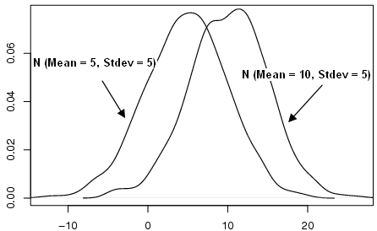
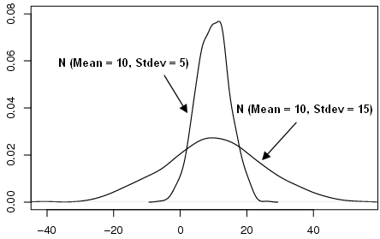
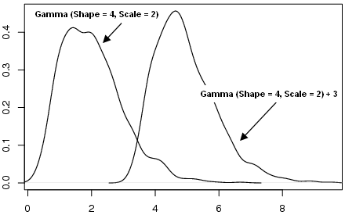
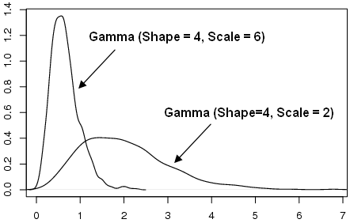
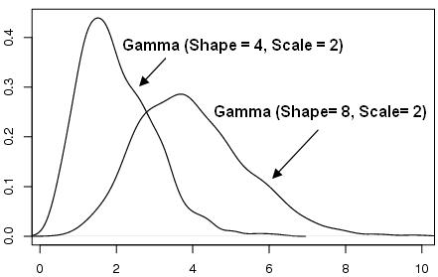
Examples (Simulation)
H0: Equality of means
H1: Means differ
t-test for equal variances
t-test for unequal variances
H0: P(X < Y) = P(X > Y)
H1: P(X < Y) ≠ P(X > Y)
Shift model satisfied
Shift model is not satisfied
Shift model is not satisfied

Slide 11
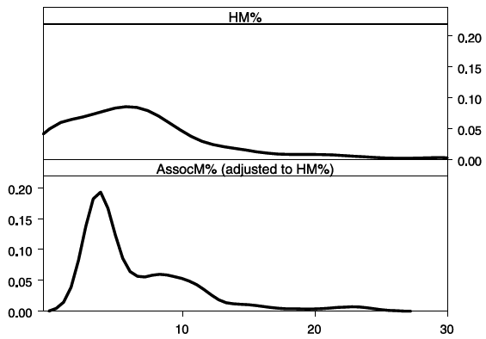
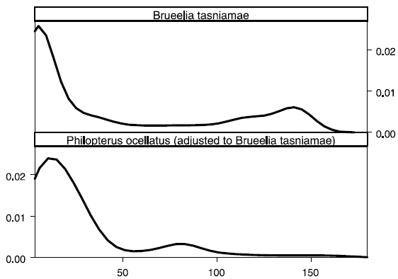
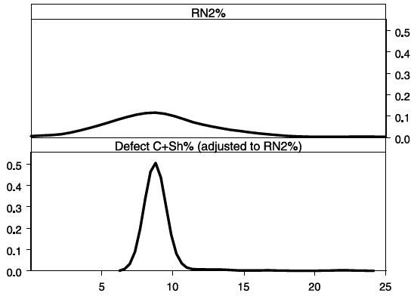
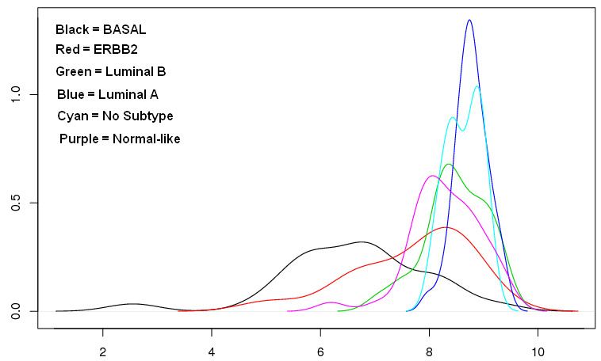
Examples (Real Data)
H0: P(X < Y) = P(X > Y)
H1: P(X < Y) ≠ P(X > Y)

Slide 12
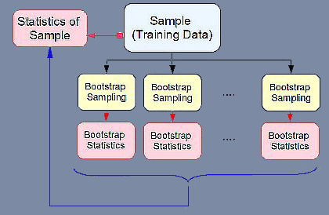
Bootstrap tests
Bootstrap*: Estimation via resampling with replacement from the empirical distribution (data sample)
B bootstrap subsamples
B bootstrap statistics (e.g. test statistic)
Find empirical distribution of B bootstrap statistics (null) and form the bootstrap test
Assumptions: (i) Original sample is a valid representative of the population
(ii) Subsamples come from the same distribution (i.i.d)
(iii) Each subsample is drawn independently of other subsamples
* Efron & Tibshirani (1993). An Introduction to the Bootstrap, New York, Chapman and Hall

Slide 13
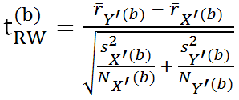
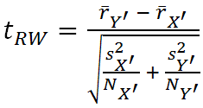
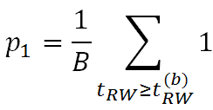
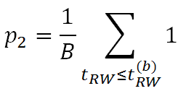
Proposed Bootstrap test (rank Welch)
H0: P(X = Basal < Y = Luminal A) = P(X = Basal > Y = Luminal A)
H1: P(X = Basal < Y = Luminal A) ≠ P(X = Basal > Y = Luminal A)
Transform X into X’ and Y into Y’ so that P(X’ < Y’) = P(X’ > Y’)
Draw B bootstrap samples of size N_{x’} from X’ and B bootstrap samples of size N_{Y’} from Y’
Calculate the b = 1, 2, …, B test statistics (the null distribution):
: means of ranks in the pooled b sample
s : standard deviation of ranks in the pooled b sample
N: b sample size
4. Calculate the test statistic of the original data:
r:: means of ranks in the pooled sample
s : standard deviation of ranks in the pooled sample
N: sample size
5. Estimate and so that p = 1 – (2*min(p₁ , p₂ ))

Slide 14
Simulation Study
Compare Bootstrap rank Welch test (BRW) with:
Wilcoxon/Mann-Whitney test (WMW) --- usual WMW test
Rank Welch test (RW) --- compute the t_{rw} statistic (without bootstrap)
Brunner-Munzel test (BM) --- Student t-test with different df estimation
Simulated distributions:
Uniform and Gaussian
Bimodal (mixture of Gaussians)
Empirical parasite intensity distributions
Empirical distributions of variables of the Rorschach test (test for psychological evaluation of patients)
Comparison:
Create stochastically equal distributions (adjustment) and check type I error rates.

Slide 15
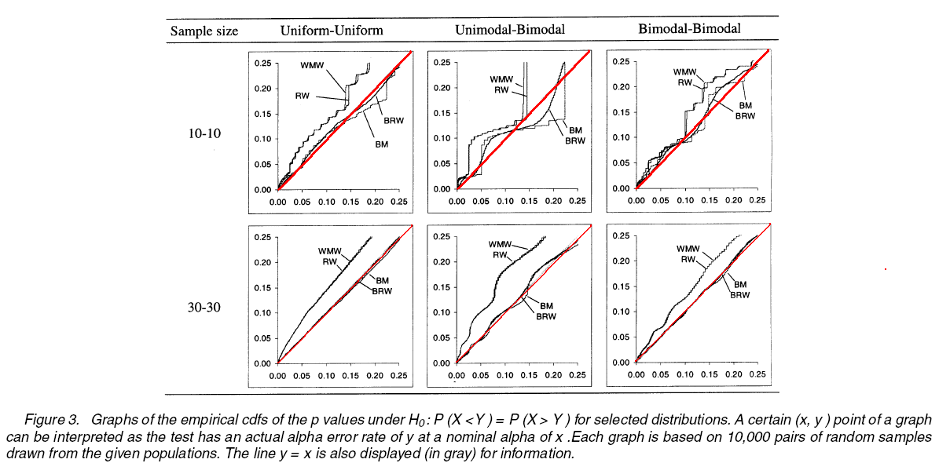
Results (simulation)
BRW performs better than any other test
Second best is the BM test
WMW and RW perform poorly

Slide 16
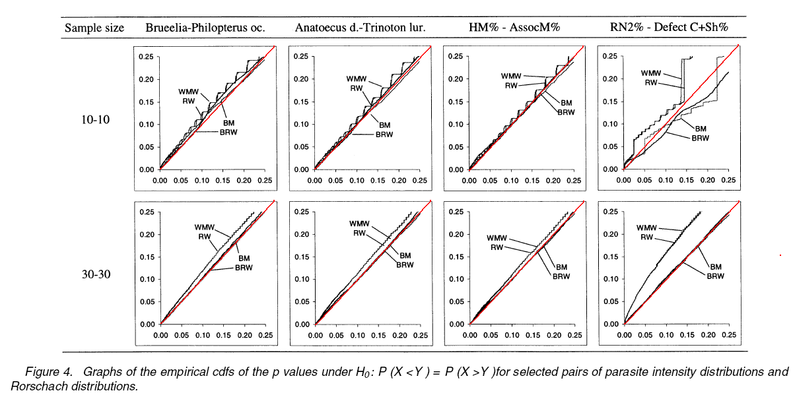
Results (Real Data)
BRW performs better than any other test
Second best is the BM test
WMW and RW perform poorly

Slide 17
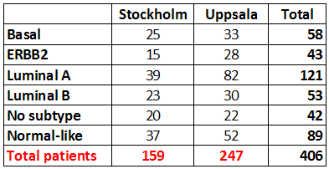
Our study (Basal Cancer)
We want to identify genes that can adequately separate Basal, ERBB2 & Luminal B carcinomas from each other as well as from other types of cancer (identified by Sorlie et al, 2003)
Basal – ERBB2, Basal – Luminal B, Basal – Luminal A, Basal – No Subtype, Basal – Normal
ERBB2 – Luminal B, ERBB2 – Luminal A, ERBB2 – No Subtype, ERBB2 – Normal
Luminal B – Luminal A, Luminal B – No Subtype, Luminal B – Normal

Slide 18
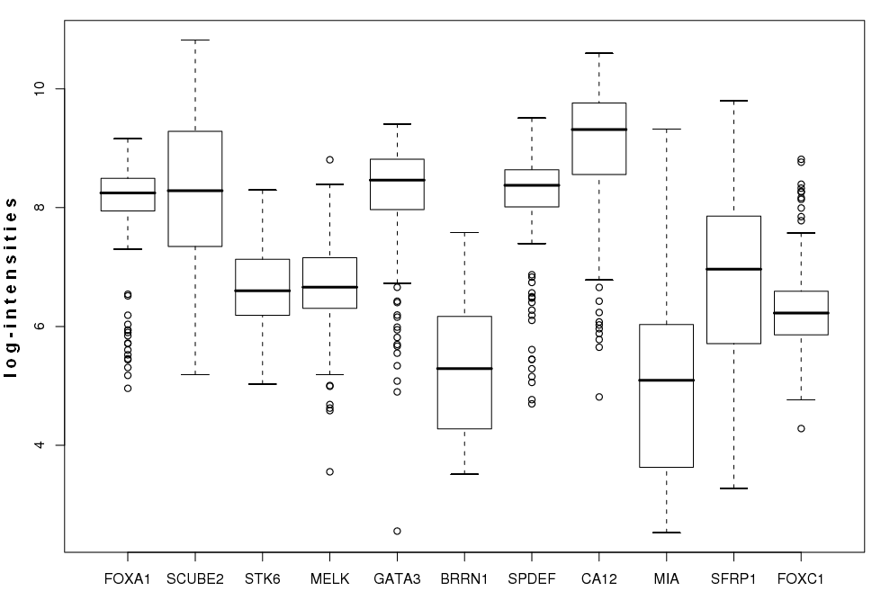
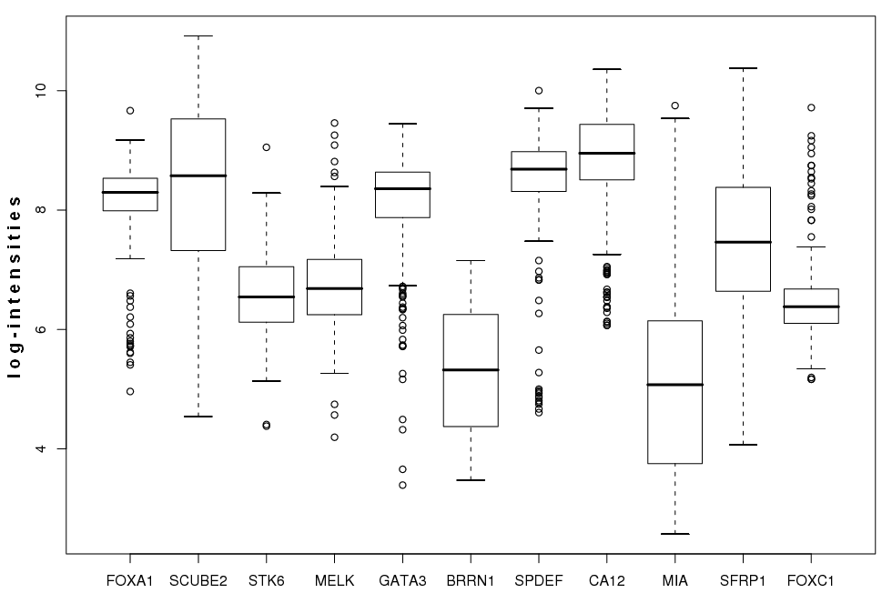
Distribution of Gene Intensities (Boxplots)
Stockholm
Uppsala

Slide 19
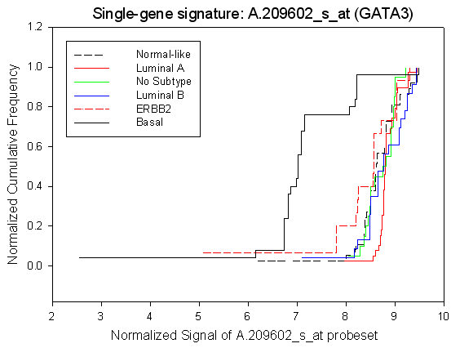
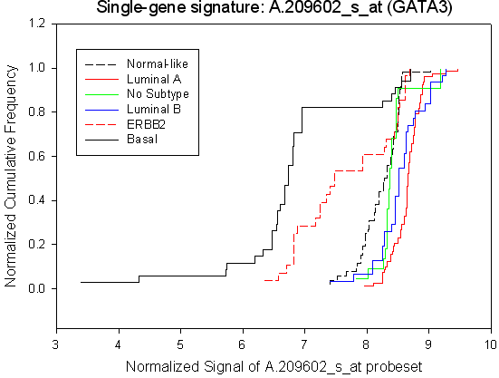
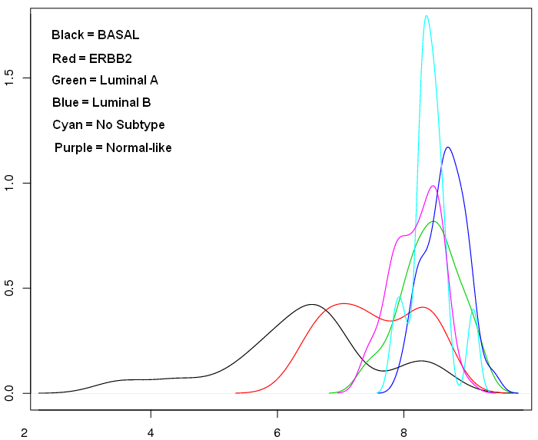
Distributions of selected genes
Stockholm cohort
Uppsala cohort

Slide 20
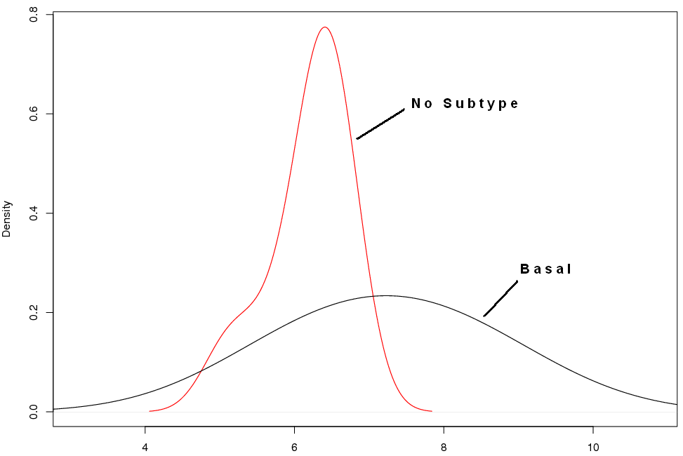
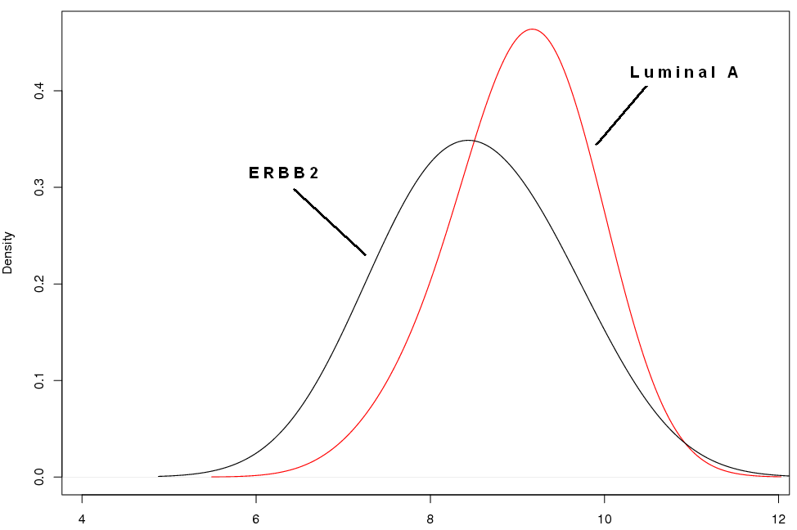
Test Results
Run BRW test (1000 bootstrap replicates) & usual WMW test and check differences in significance level a = 1%
FOXC1: Stockholm
SPDEF: Uppsala
BRW: No difference; WMW: Difference
BRW: Difference; WMW: No Difference

Slide 21
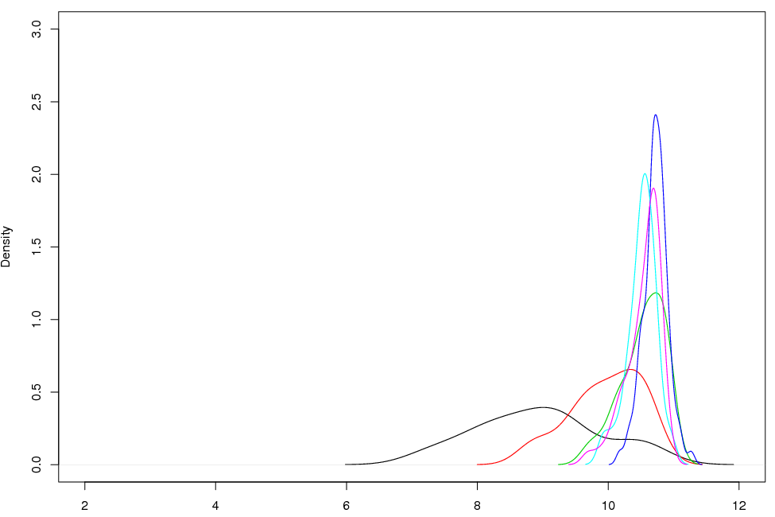
Summary Results
Typical example: GATA 3 (Uppsala)
Most of the differences in the p-values of BRW & WMW are observed when we compare the basal (black) or ERBB2 (red) with the other subtypes of carcinomas
More examples (differences across methods; validated in both cohorts)
SCUBE2: Comparison ERBB2 – Luminal B
GATA3: Comparison Luminal B – Luminal A
SPDEF: Comparison ERBB2 - Norm
FOXC1: Comparison Basal – Normal like

Slide 22
Comments
The paper has been published in a leading statistical journal quite recently
The problem addressed is very interesting and relevant to many problems in computational biology
The authors showed that their method works well (mathematically) but they do not show any biological results
They do not comment on the problem of iid observations within samples. How to modified bootstrap for dependent within-sample observations and what results we get?
What about the case of dependent samples? What if one substituted the t_{rw} statistic with the corresponding statistic of the dependent case?
What if we work with unequal sample sizes?

